Slide 1






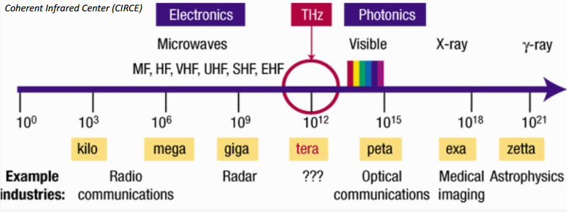
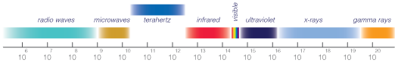
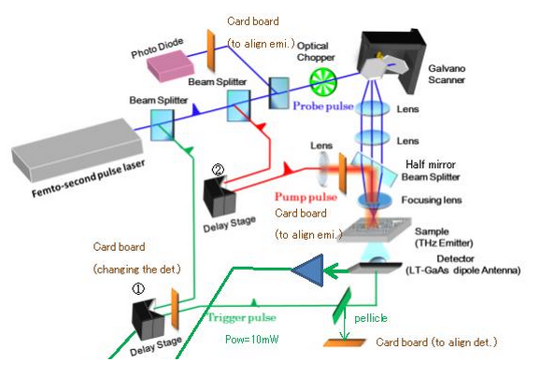
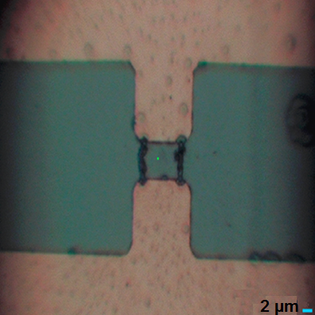
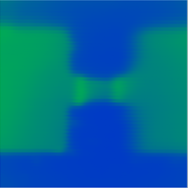
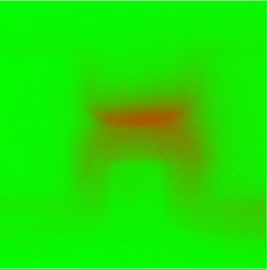
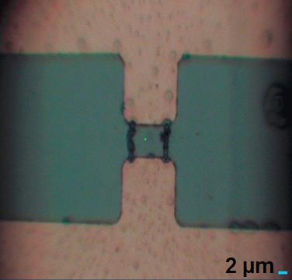
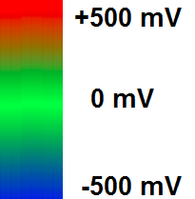


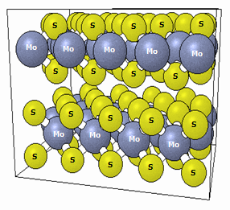
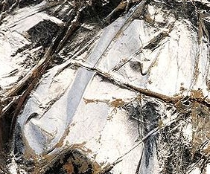
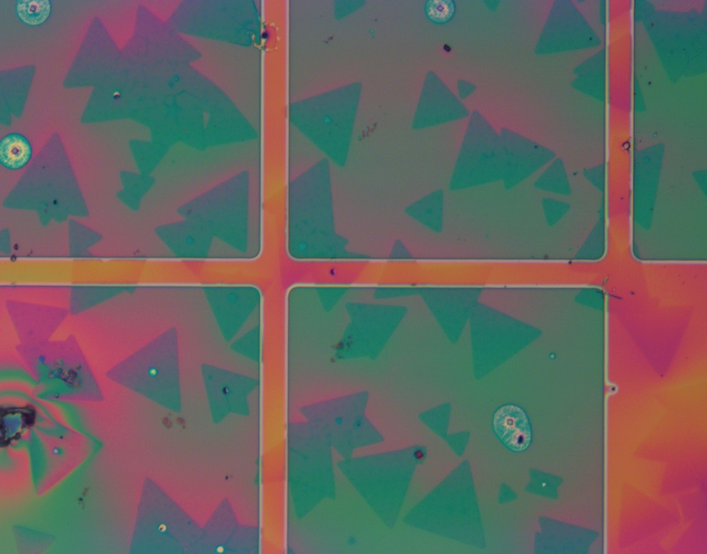
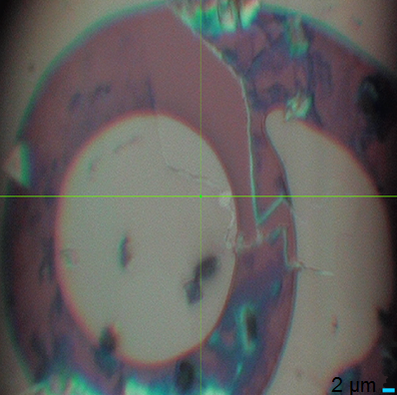

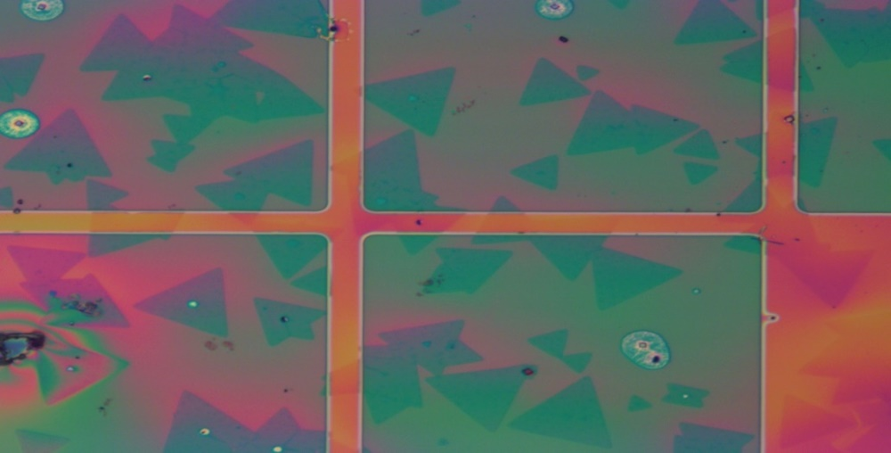
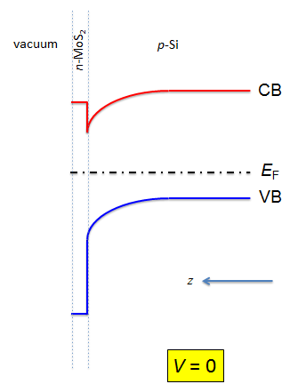
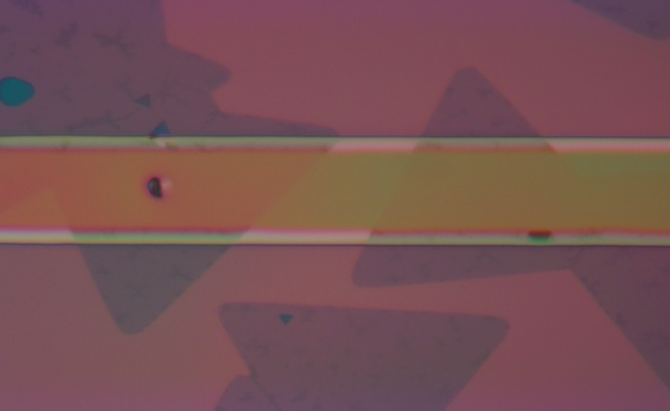
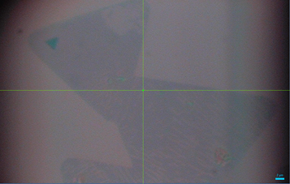
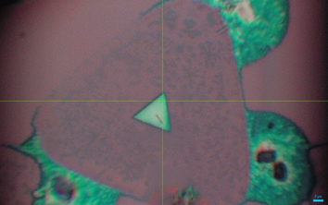
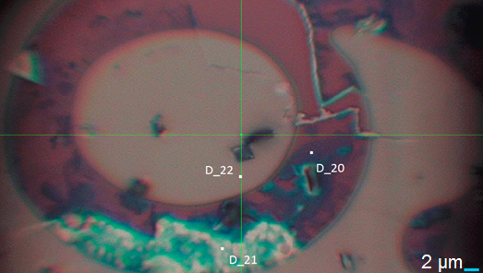
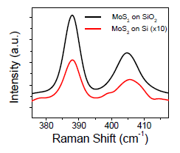
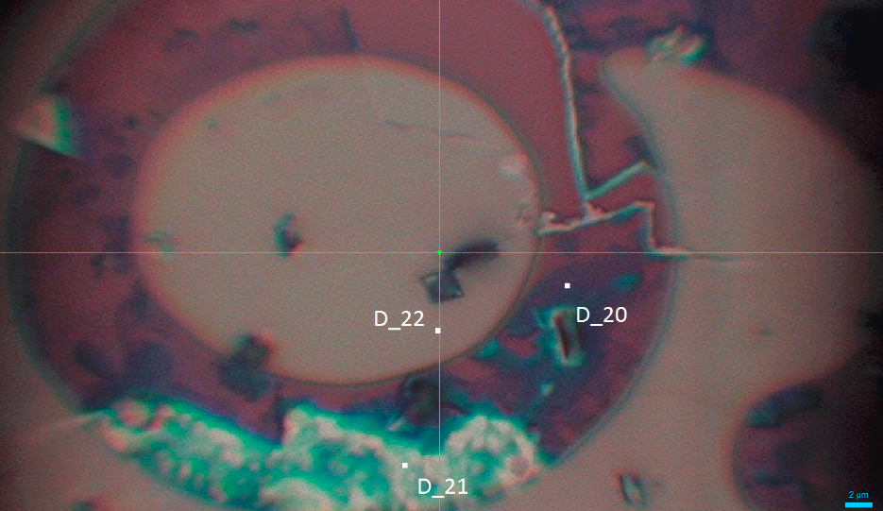
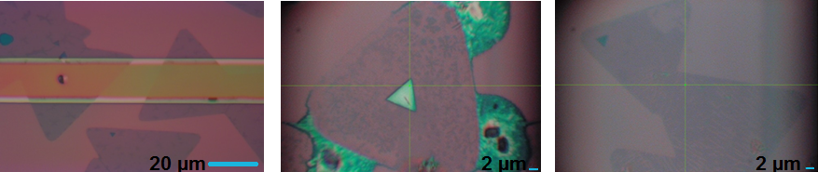
Characterizing MoS2-Si p-n Heterojunction Using Laser Terahertz Emission Spectroscopy
Rebecca Wong,^{1,2,3} F.R. Bagsican,³ I. Kawayama,³ M. Tonouchi,³ B. Li,⁴ R. Vajtai,⁴ P. Ajayan,⁴ and J. Kono^{2,4}
¹ Department of Physics, Grinnell College
² Department of Electrical and Computer Engineering and NanoJapan Program, Rice University
³ Institute of Laser Engineering, Osaka University, Japan
⁴ Department of Materials Science and NanoEngineering, Rice University
Introduction
Methodology
Results and Discussion
The “Terahertz Gap”
Spectral region 0.3 – 3.0 THz (1 mm - 100 µm)
Terahertz Imaging
Determine if there is terahertz emission from MoS2 p-n heterojunction
Raman Microscopy and Spectroscopy
Monitor the deterioration of MoS2 p-n heterojunction and categorize different materials within the sample
Current alignment and resolution of system
Photoconductive antenna
Introduction
Framework
Results and Discussion
Atomically thin two-dimensional (monolayer/2D) materials differ significantly from bulk (3D) counterparts
Van der Waals bonds (2D) vs. covalent bonds (3D)
MoS2 characteristics
Direct band gap of 1.8 eV (2D) vs. indirect band gap of 1.3 eV (3D)
Stable charge exciton state at room temperature (2D)
Unique applications for optoelectronic and electronic devices
Final frontier for improving optoelectronic and electronic devices
Low energy usage
Framework
Atomically thin two-dimensional (monolayer/2D) materials differ significantly from bulk (3D) counterparts
Van der Waals bonds (2D) vs. covalent bonds (3D)
MoS2 characteristics
Direct band gap of 1.8 eV (2D) vs. indirect band gap of 1.3 eV (3D)
Stable charge exciton state at room temperature (2D)
Unique applications for optoelectronic and electronic devices
Microscope Image
Optical Image
Terahertz Image
Image of photoconductive antenna is distinguishable
Fig. 1: Atomic structure of MoS2
Fig. 2: Bulk MoS2 Sample
Fig. 3: Monolayer MoS2 Sample
Objectives
Fig. 5: Schematic of terahertz system setup.
Fig. 1: Atomic structure of MoS2
Fig. 2: Bulk MoS2 sample
Fig. 3: Monolayer MoS2 sample
Fig. 5: Schematic of terahertz system setup
Objectives
Results and Discussion
Microscope Image
Optical Image
Investigate 2D-3D heterojunction MoS2-Si
n-type (electron majority carrier) monolayer MoS2 and p-type (hole majority carrier) bulk Si
Gain new insight into the nature of the MoS2-Si p-n junction energy states
Band alignment
Band bending
Understand how the properties of 2D-3D junctions differ from those of conventional 3D-3D junctions
Results and Discussion
Optical image can discern outline of number
However, cannot detect monolayer Raman spectroscopy-confirmed MoS2 (D_20) on “9”
Resolution is not good enough for terahertz imaging
Investigate 2D-3D heterojunction MoS2-Si
n-type (electron majority carrier) monolayer MoS2 and p-type (hole majority carrier) bulk Si
Gain new insight into the nature of the MoS2-Si p-n junction energy states
Band alignment
Band bending
Understand how the properties of 2D-3D junctions differ from those of conventional 3D-3D junctions
Fig. 6 (left): Raman spectroscopy sampling areas of MoS2-Si with PMMA removed
Fig. 7 (right): Previously found Raman peaks of MoS2 on silicon and silicon dioxide¹
Conclusions and Future Work
Finer tuning will be required to achieve higher quality optical images and terahertz images
Currently resolution up to 5 µm
Resolution up to 1 µm achievable
Delay the deterioration of p-n junction
Determine the thickness of resultant bulk MoS2 layers
Understand why oxidization of silicon results in conglomeration of MoS2
Conclusions and Future Work
Fig. 7 (left): Sample areas of MoS2-Si with PMMA removed.
Fig. 8 (right): Previously found Raman peaks of MoS2 on silicon and silicon dioxide.¹
Finer tuning will be required to achieve higher quality optical images and terahertz images
Currently resolution is ~5 µm
Resolution up to ~1 µm achievable
Delay the deterioration of p-n junction
Determine the thickness of resultant bulk MoS2 layers
Understand why oxidization of silicon results in conglomeration of MoS2
Fig. 4: Band diagram of MoS2-Si heterojunction.¹
References
Methodology
Fig. 4: Band diagram of MoS2-Si heterojunction¹
Reference
Methodology
¹ Bo Li et al., in preparation
Terahertz Emission Spectroscopy and Imaging
Sensitive to electric fields in MoS2-Si heterojunction
Map out distribution of electric fields (band bending)
Optical Imaging
Confirm reflective imaging capabilities
Acknowledgments
Laser Terahertz Emission Spectroscopy and Imaging
Sensitive to electric fields in MoS2-Si heterojunction
Map out distribution of electric fields (band bending)
Optical Imaging
Determine resolution of system
Optimize alignment of system in order to perform terahertz imaging
D_20 and D_21 have Raman peaks characteristic of monolayer and bulk MoS2 respectively
D_22 has Raman peaks characteristic of silicon only
¹ Bo Li et al., in preparation
Acknowledgments
This research project was conducted as part of the 2015 NanoJapan: International Research Experience for Undergraduates Program with support from a National Science Foundation Partnerships for International Research & Education grant (NSF-PIRE OISE-0968405). For more information on NanoJapan see http://nanojapan.rice.edu.
Further inquiries can be directed to wongrebe17@grinnell.edu
Fig. 8: Furthermost left image is of the sample freshly prepared. The other two images are of the sample one month later. All images are magnification X100. The furthermost right two Images were acquired using Horiba XploRA ONE Raman microscope.
This research project was conducted as part of the 2015 NanoJapan: International Research Experience for Undergraduates Program with support from a National Science Foundation Partnerships for International Research & Education grant (NSF-PIRE OISE-0968405). For more information on NanoJapan see http://nanojapan.rice.edu. Further inquiries can be directed to wongrebe17@grinnell.edu

